Slide 1
PATSAN MITRA
By 183_MindFreak

Slide 2
PROBLEM STATEMENT
Implementing and tracking of certified jute seeds from supplier to jute farmers in India.

Slide 3
PROBLEM ADDRESSED
As of now, the National Jute Board(NJB) does not know the jute seed suppliers. They don’t have contact with seed suppliers.
Farmers are using uncertified seeds which are informally produced and lacks quality of yielding good crops.
The use of certified seeds are: it goes through standardized process which are administered by testing authorities such as NSC, State Seeds Corporation, Seed Testing Authorities, etc.

Slide 4
WHY PATSAN MITRA?
Patsan Mitra is a web based application for tracking the certified jute seeds from the supplier to jute farmers in India.
The web application provide transparency about how certified seeds are produced, distributed, and managed by various entities.

Slide 5
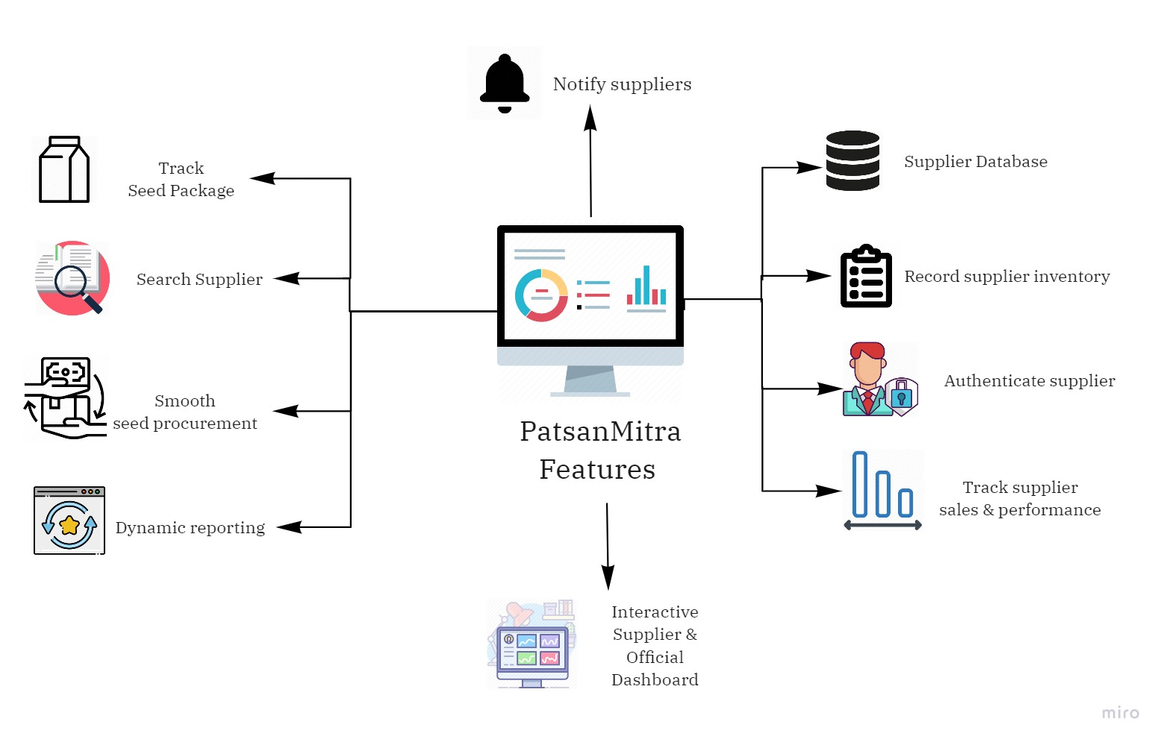
PATSAN MITRA FEATURES

Slide 6
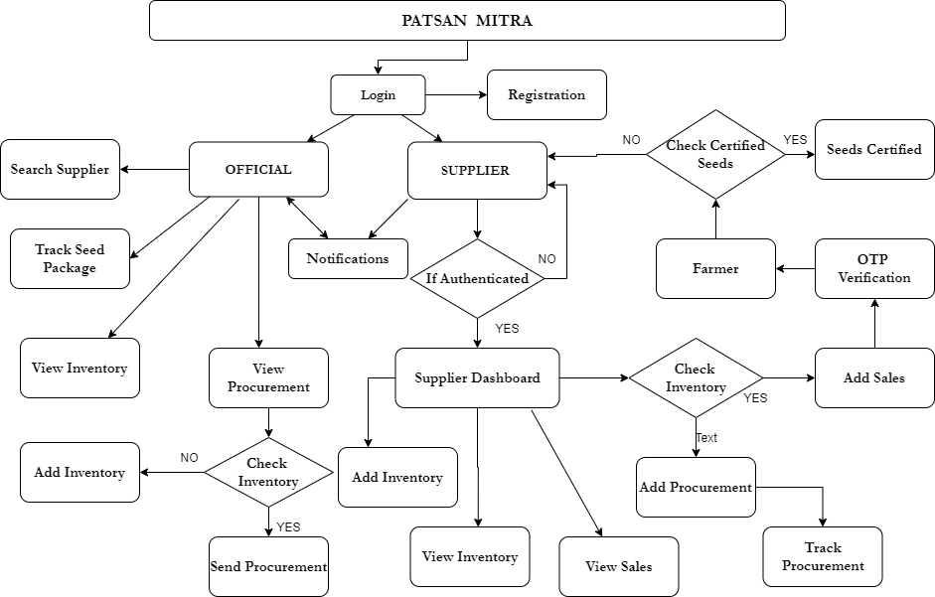
SYSTEM WORKFLOW

Slide 7
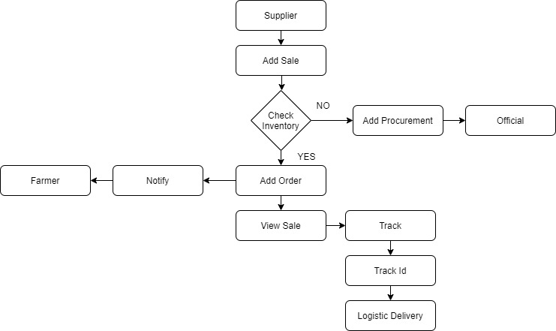
SUPPLIER TO FARMER WORKFLOW

Slide 8
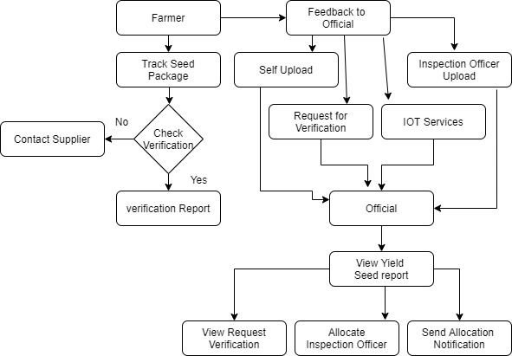
OFFICIAL TO FARMER WORKFLOW

Slide 9
THANK YOU
MINDFREAK

